Slide 1
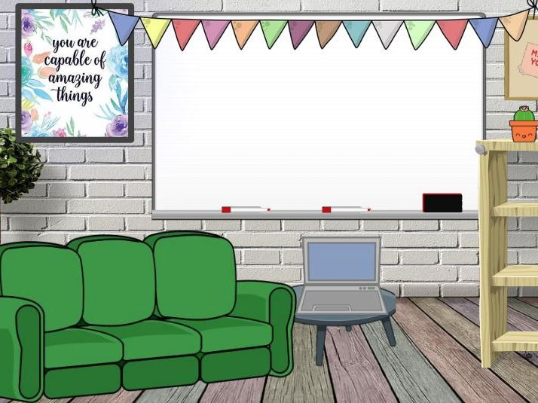
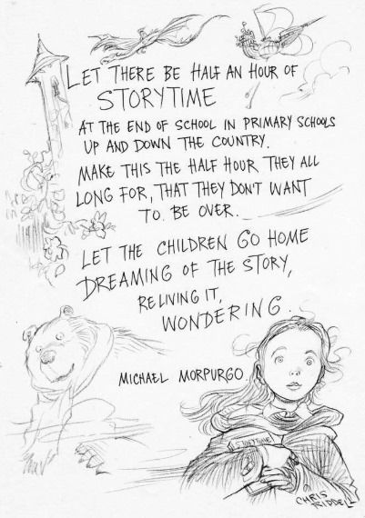
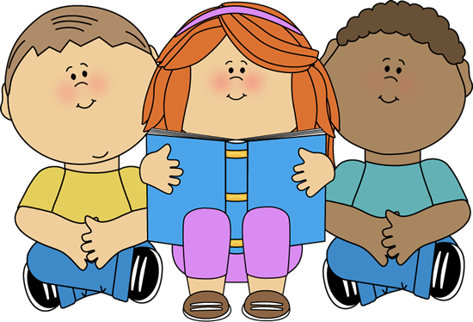
Ashlands Virtual Library

Slide 2
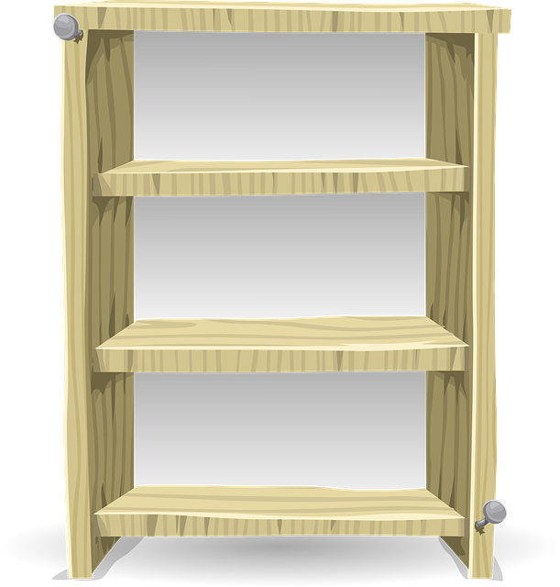
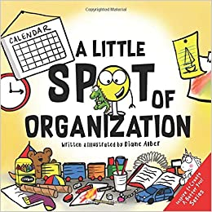
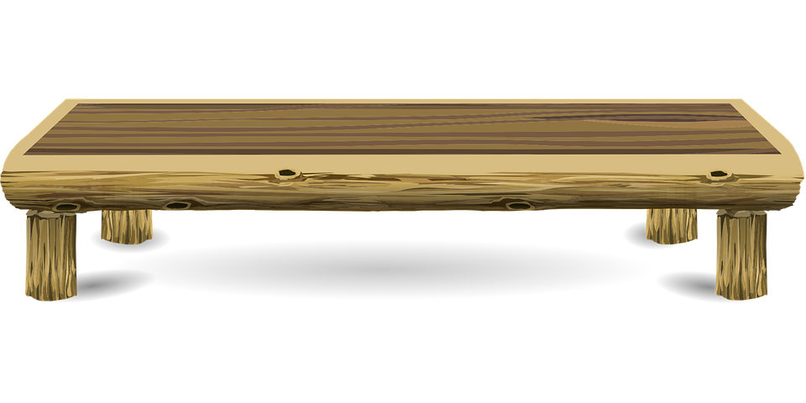
Organisation

Slide 3
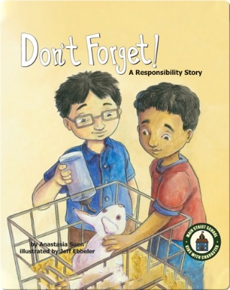
Responsibility

Slide 4
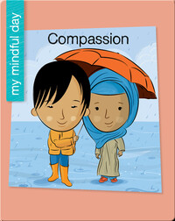
Compassion

Slide 5
High Expectations

Slide 6
Forgiveness

Slide 7
Optimism

Slide 8
Acceptance

Slide 9
Resilience

Slide 10
Collaboration

Slide 11
Pride

Slide 12
Friendship

Slide 13
Trust

