Slide 1
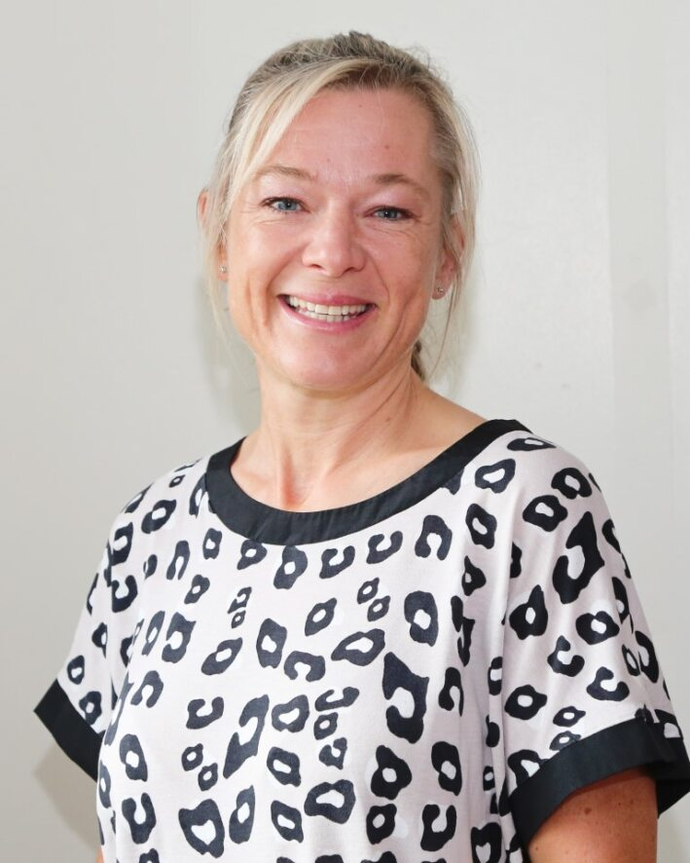
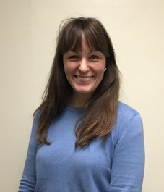
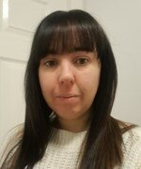
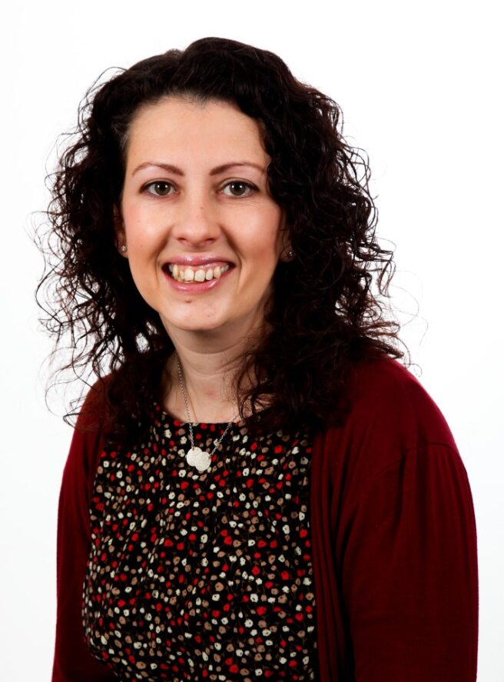
Welcome to Ashlands Reception Class
Our Class name is: Ash Class
Mrs Charlotte Smithson Miss Kate Hemming Mrs Charlotte Allum Mrs Joanne Shepherd
HLTA (AM) Class Teacher EYFS lead TA (PM) Assistant Head EYFS lead
& KS1 Lead

Slide 2
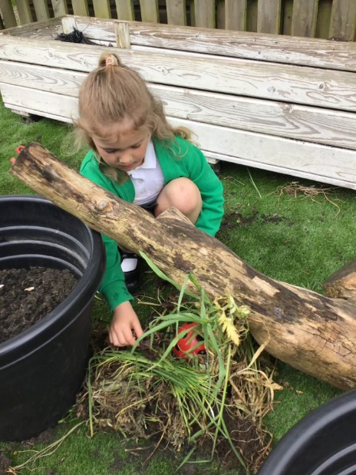
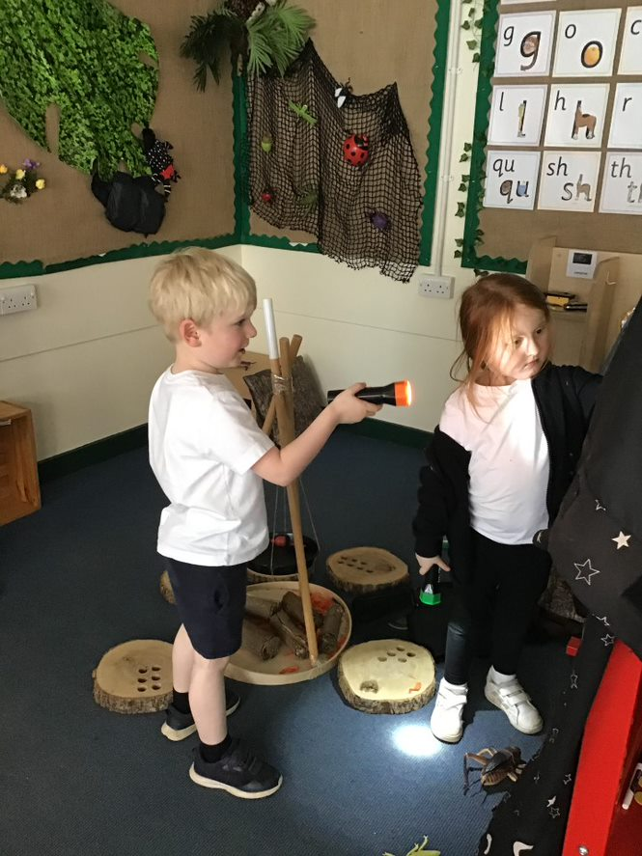
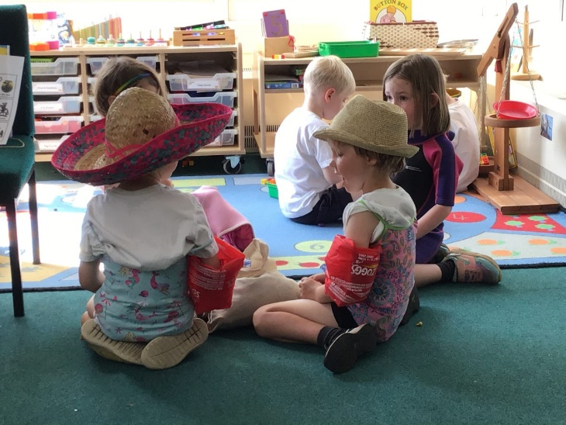
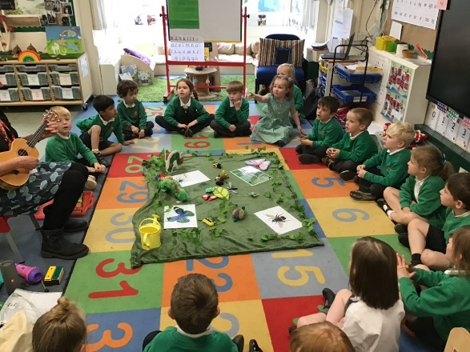
A typical day in Reception…is there such a thing?!
The classroom doors open at 8.55am, the children come in, hang up their coats and register is taken at 9am.
We then have our main phonics lesson with new sounds introduced and activities to practise these.
Children play and learn in provision areas both inside and outside.
Children are given the opportunity to choose where to play, and they
have the chance to revisit experiences and previous learning.

Slide 3
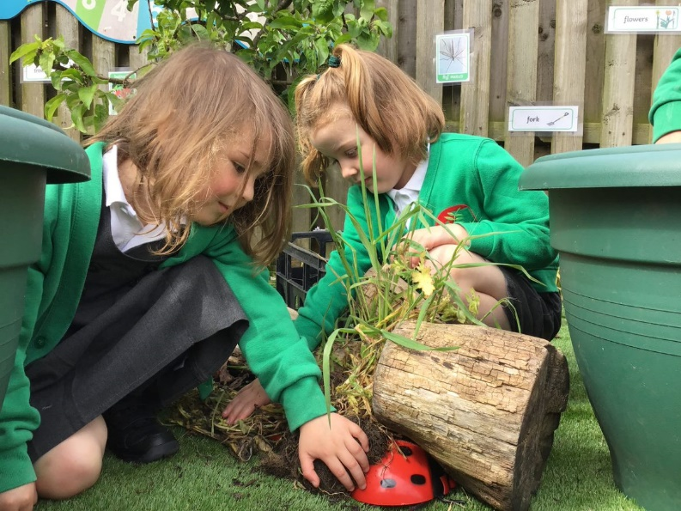
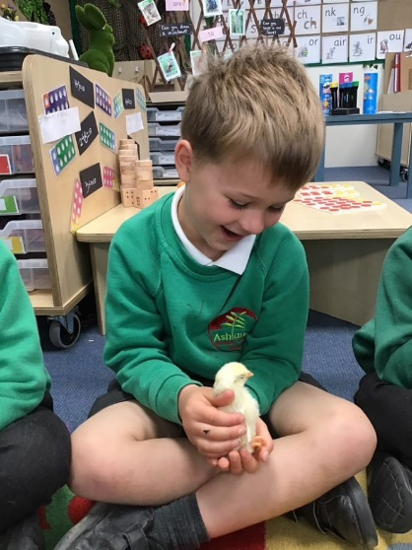
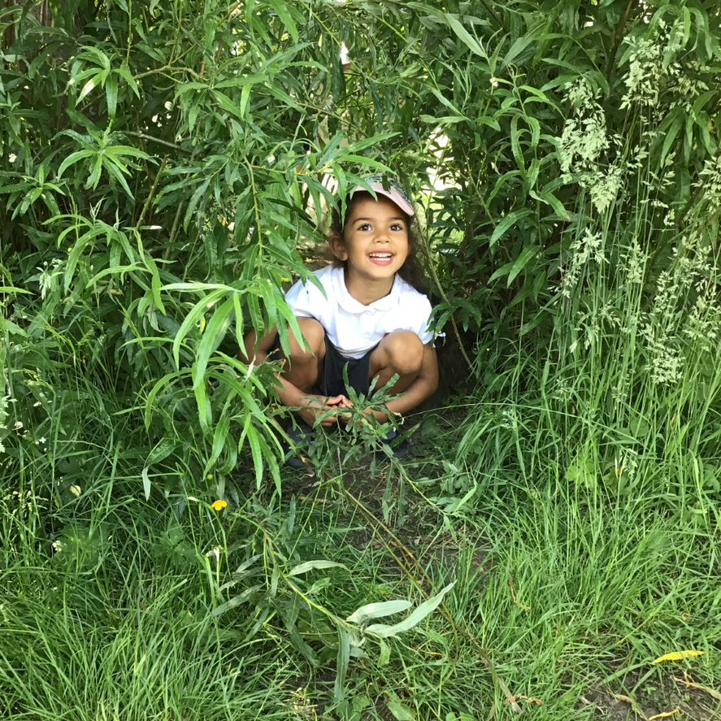
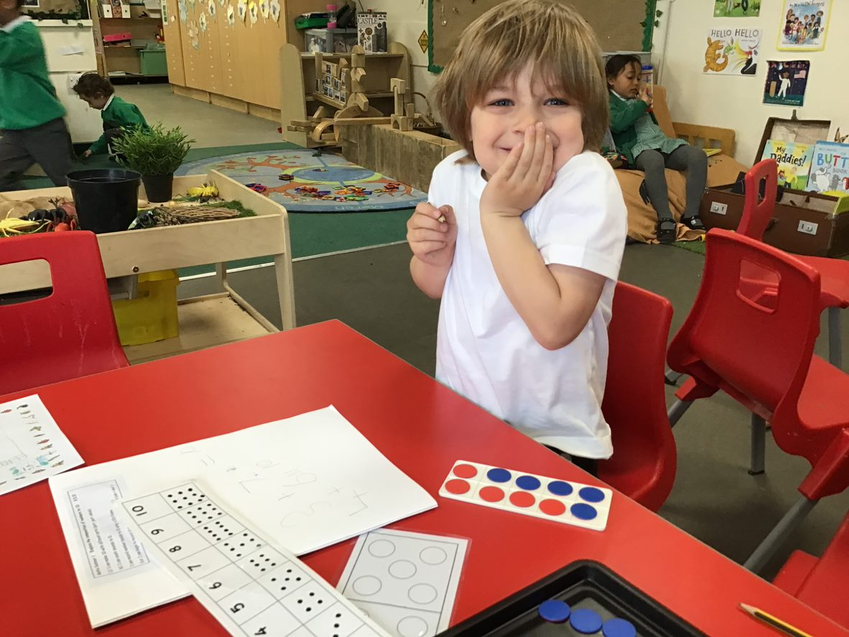
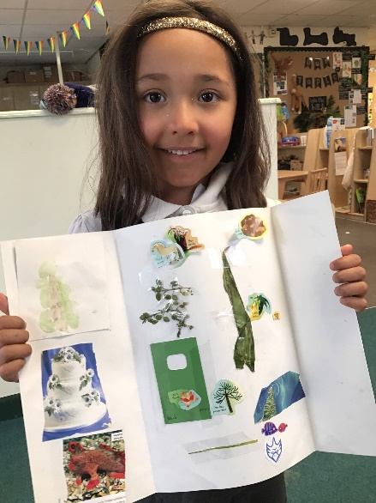
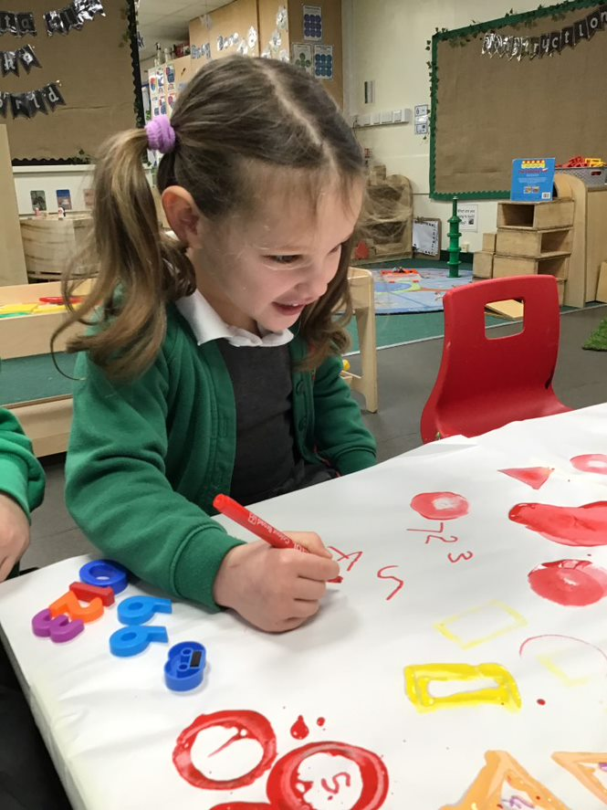

Slide 4
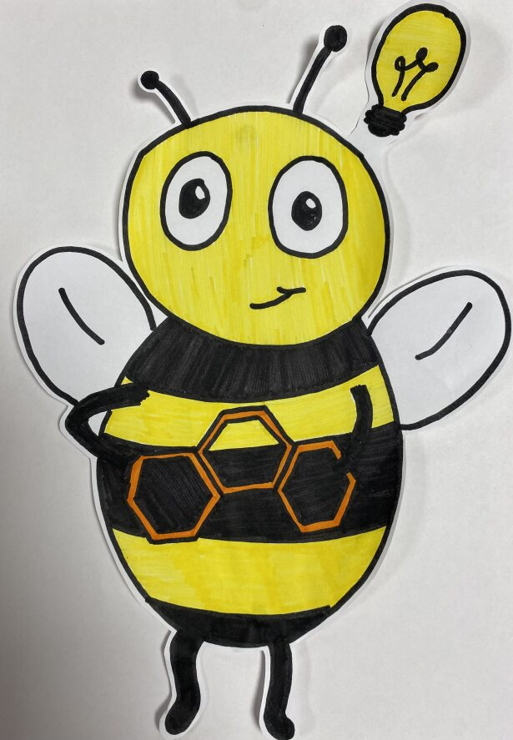
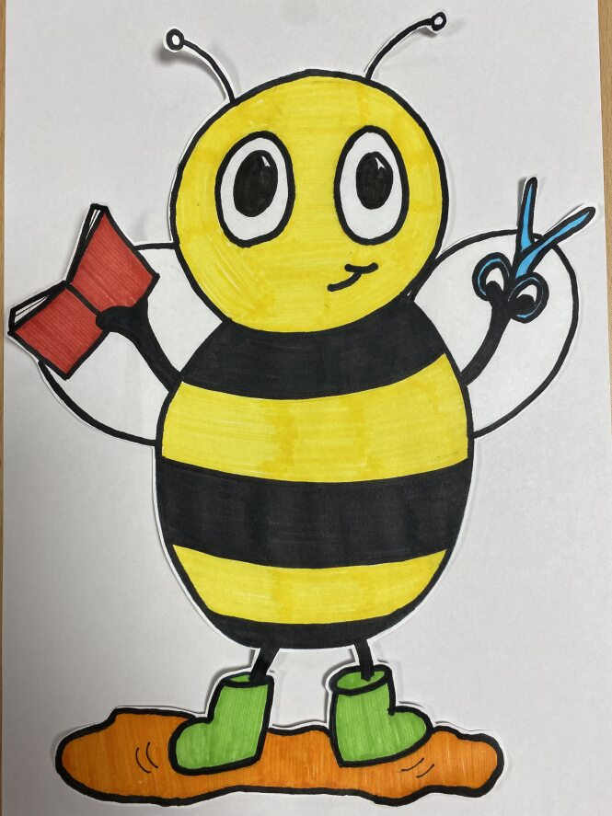
Characteristics of Effective Teaching and Learning “Children are always throwing out sparks of knowledge, curiosity, and inquiry and adults must be ready to catch those sparks.” Reggio Emilia
Team Bee
Thinking Bee
Can do Bee
Playing and exploring - children investigate and experience things, and ‘have a go’
Active learning - children concentrate and keep on trying if they encounter difficulties, and enjoy achievements
Creating and thinking critically - children have and develop their own ideas, make links between ideas, and develop strategies for doing things’

Slide 5
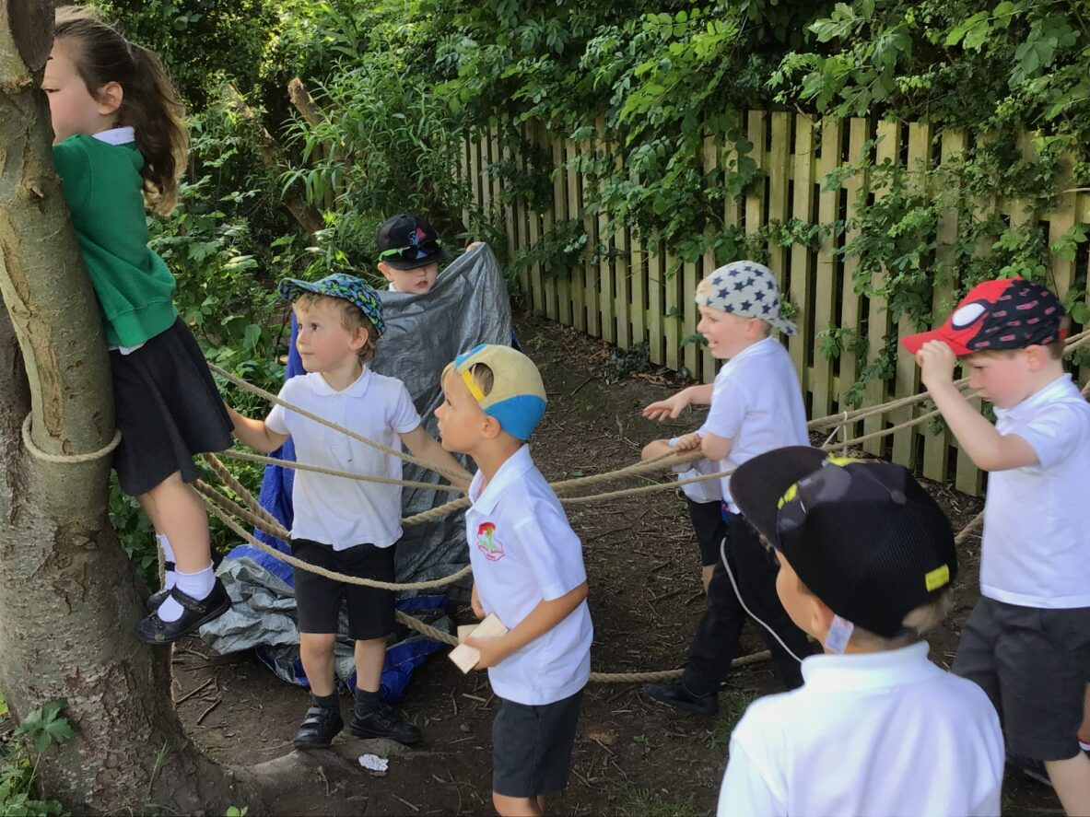
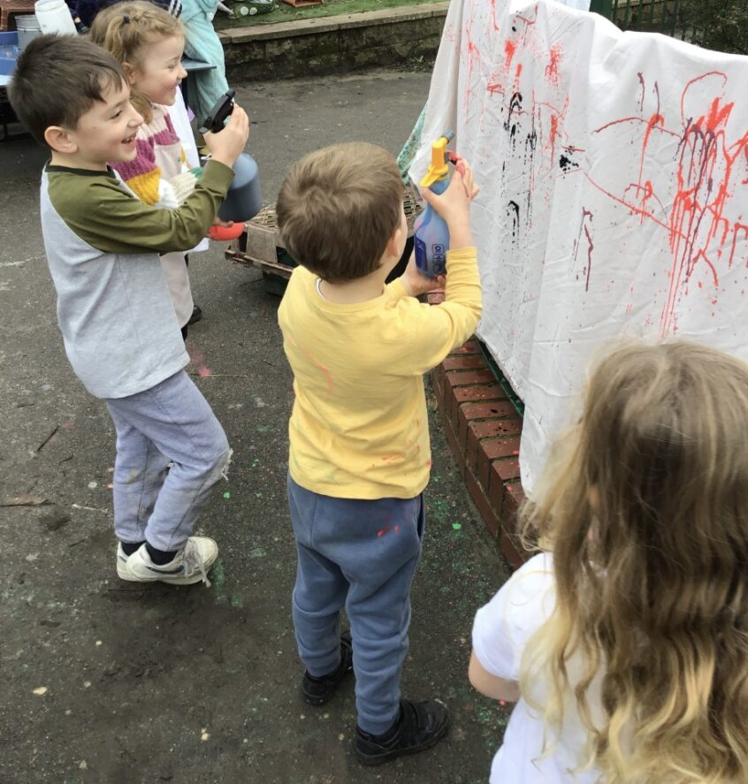
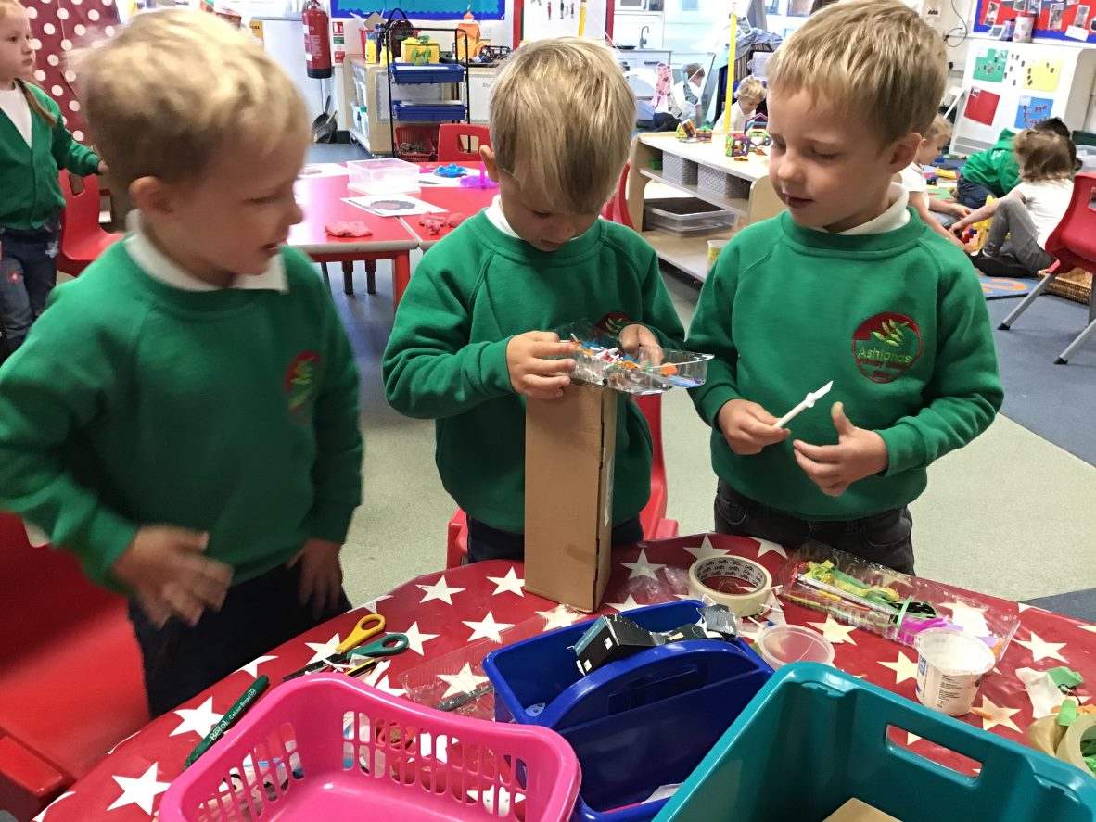
“Our classroom is like a cosy little house”
Aims for our EYFS learning space
Emotional warmth and security
Feelings of control
Cognitive challenge
Articulation of learning

Slide 6
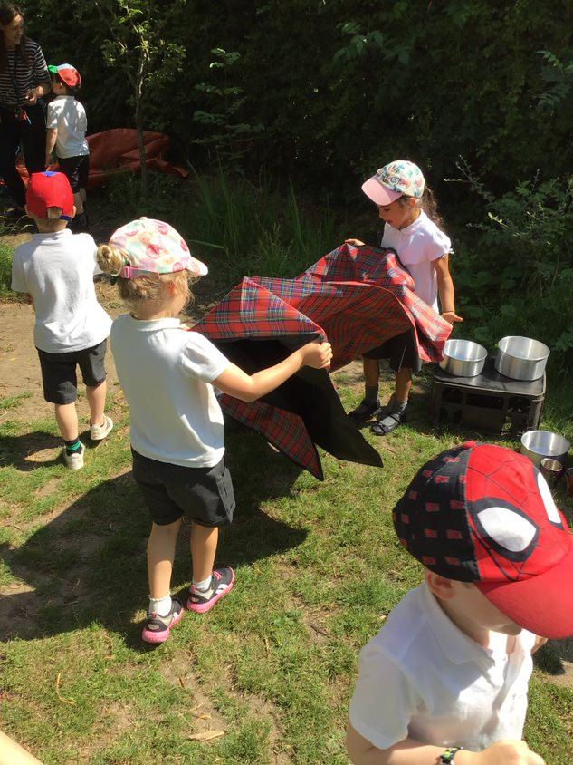
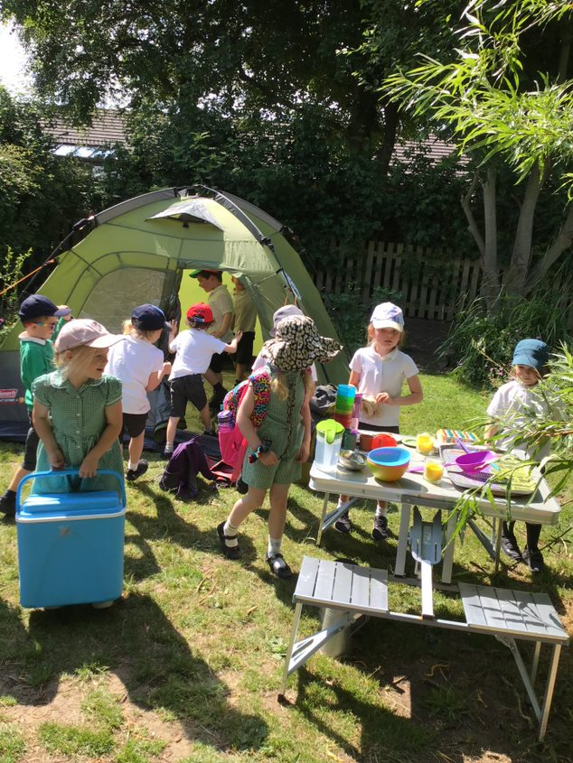
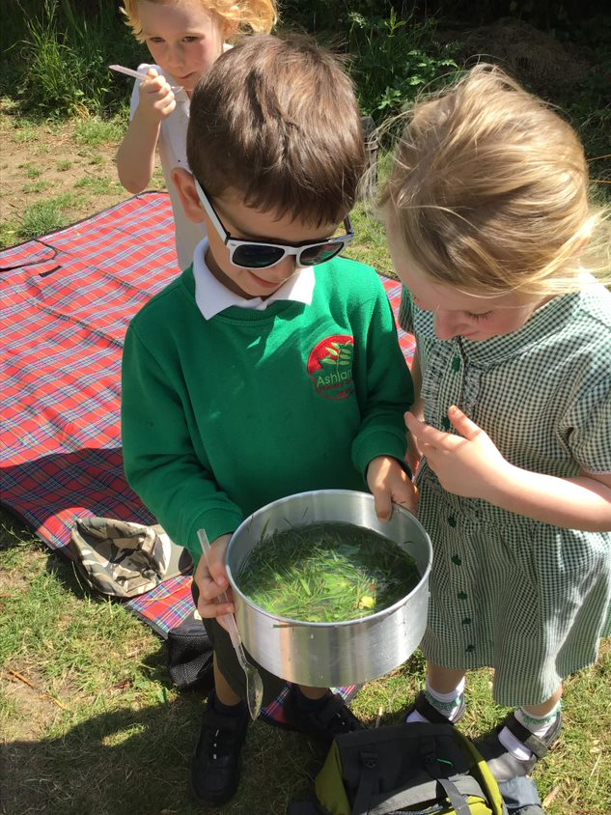
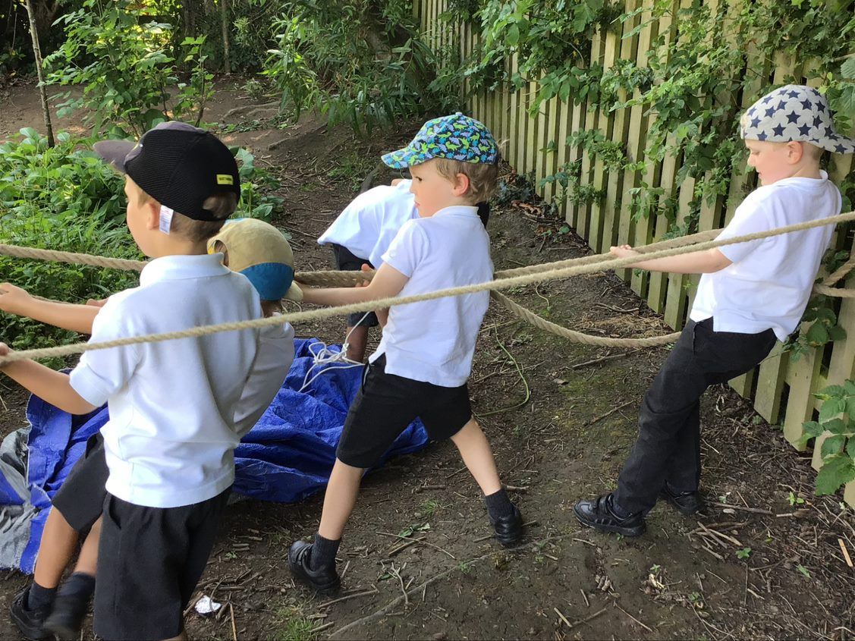
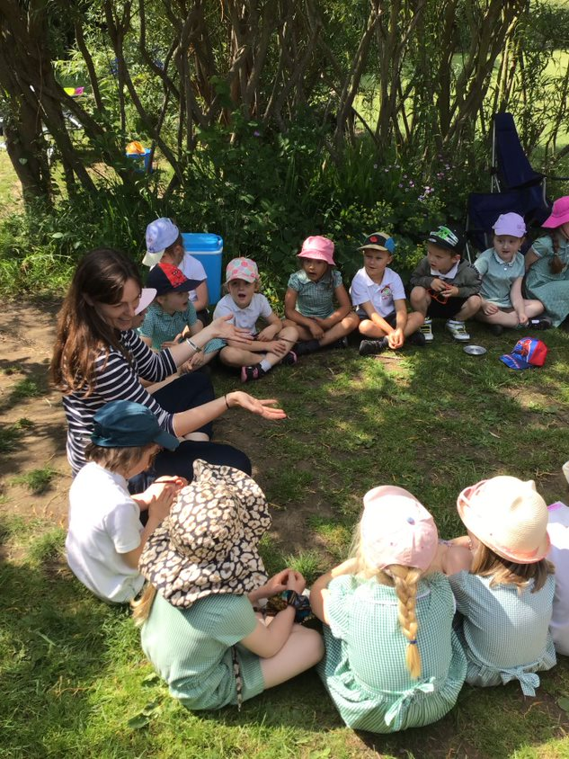
Camping holiday!

Slide 7
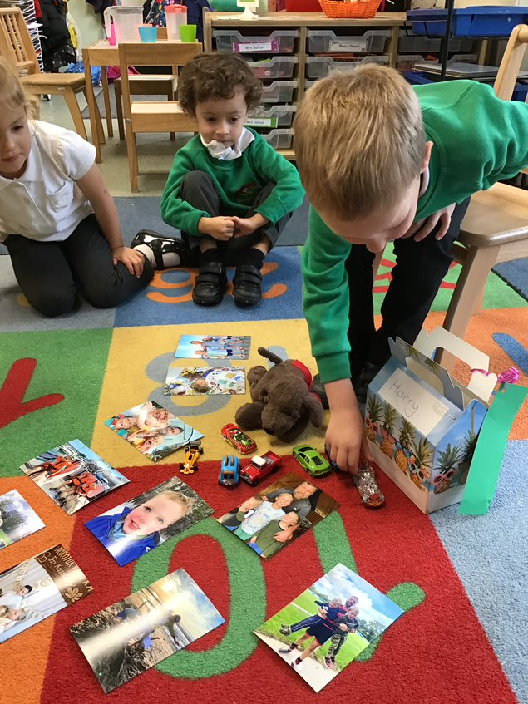
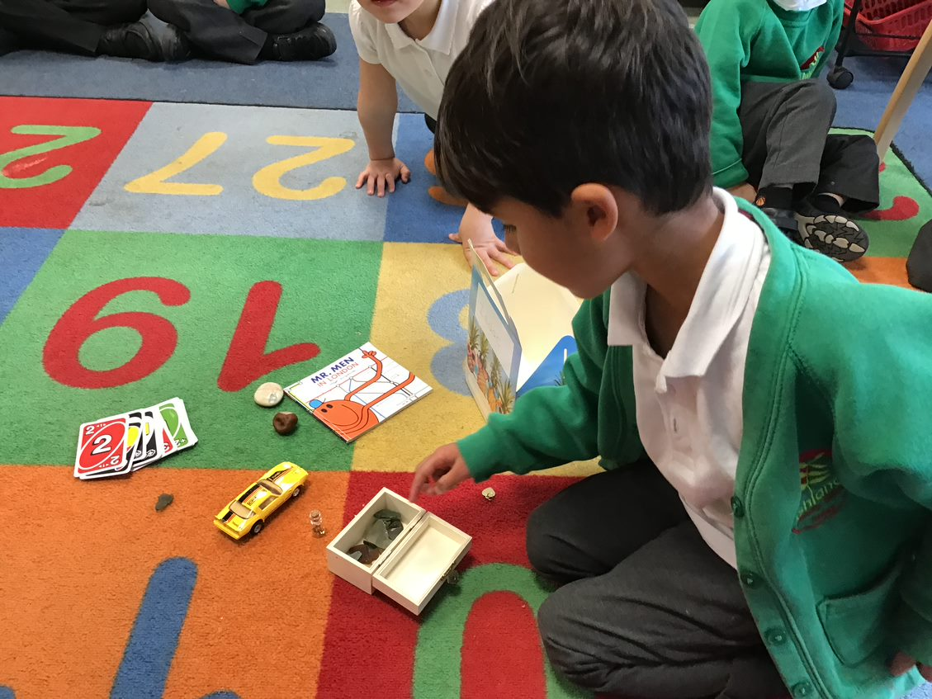
Chatterboxes
Today the children will all bring home a ‘Chatterbox’. Inside there is a Welcome letter from Year 6, and blank postcard to send to Miss Hemming.
The children can add things to the box to share with us when they come to Reception in September. Having a chance to talk about the things that are important to them is a good way of getting to know them, and building the link between home and school.
Please bring your Chatterbox in at the beginning of term. Thank you!

Slide 8
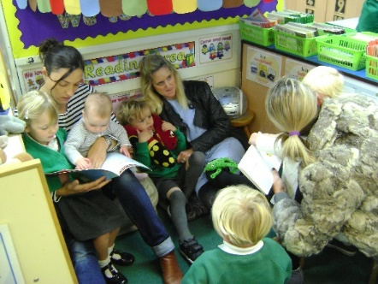
Parental Involvement
The partnership between home and school is so important and I will always make time to talk through any concerns or issues. Please either catch me on the door for a quick message or we can arrange an appointment for after school.
We keep parents informed of our topics and activities through our half termly newsletters, the school email system, Twitter and our website.
We use Tapestry to record children’s achievements and assess their learning journey.
We have termly ‘Share and Celebrate’ sessions for adults to play and share work with their child and special events for you to get involved with.
Please keep in contact!

Slide 9
Here’s to a wonderful Reception Year! 2023/24

