Slide 1

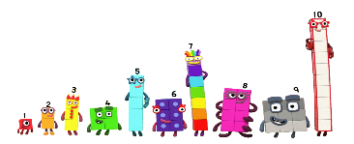
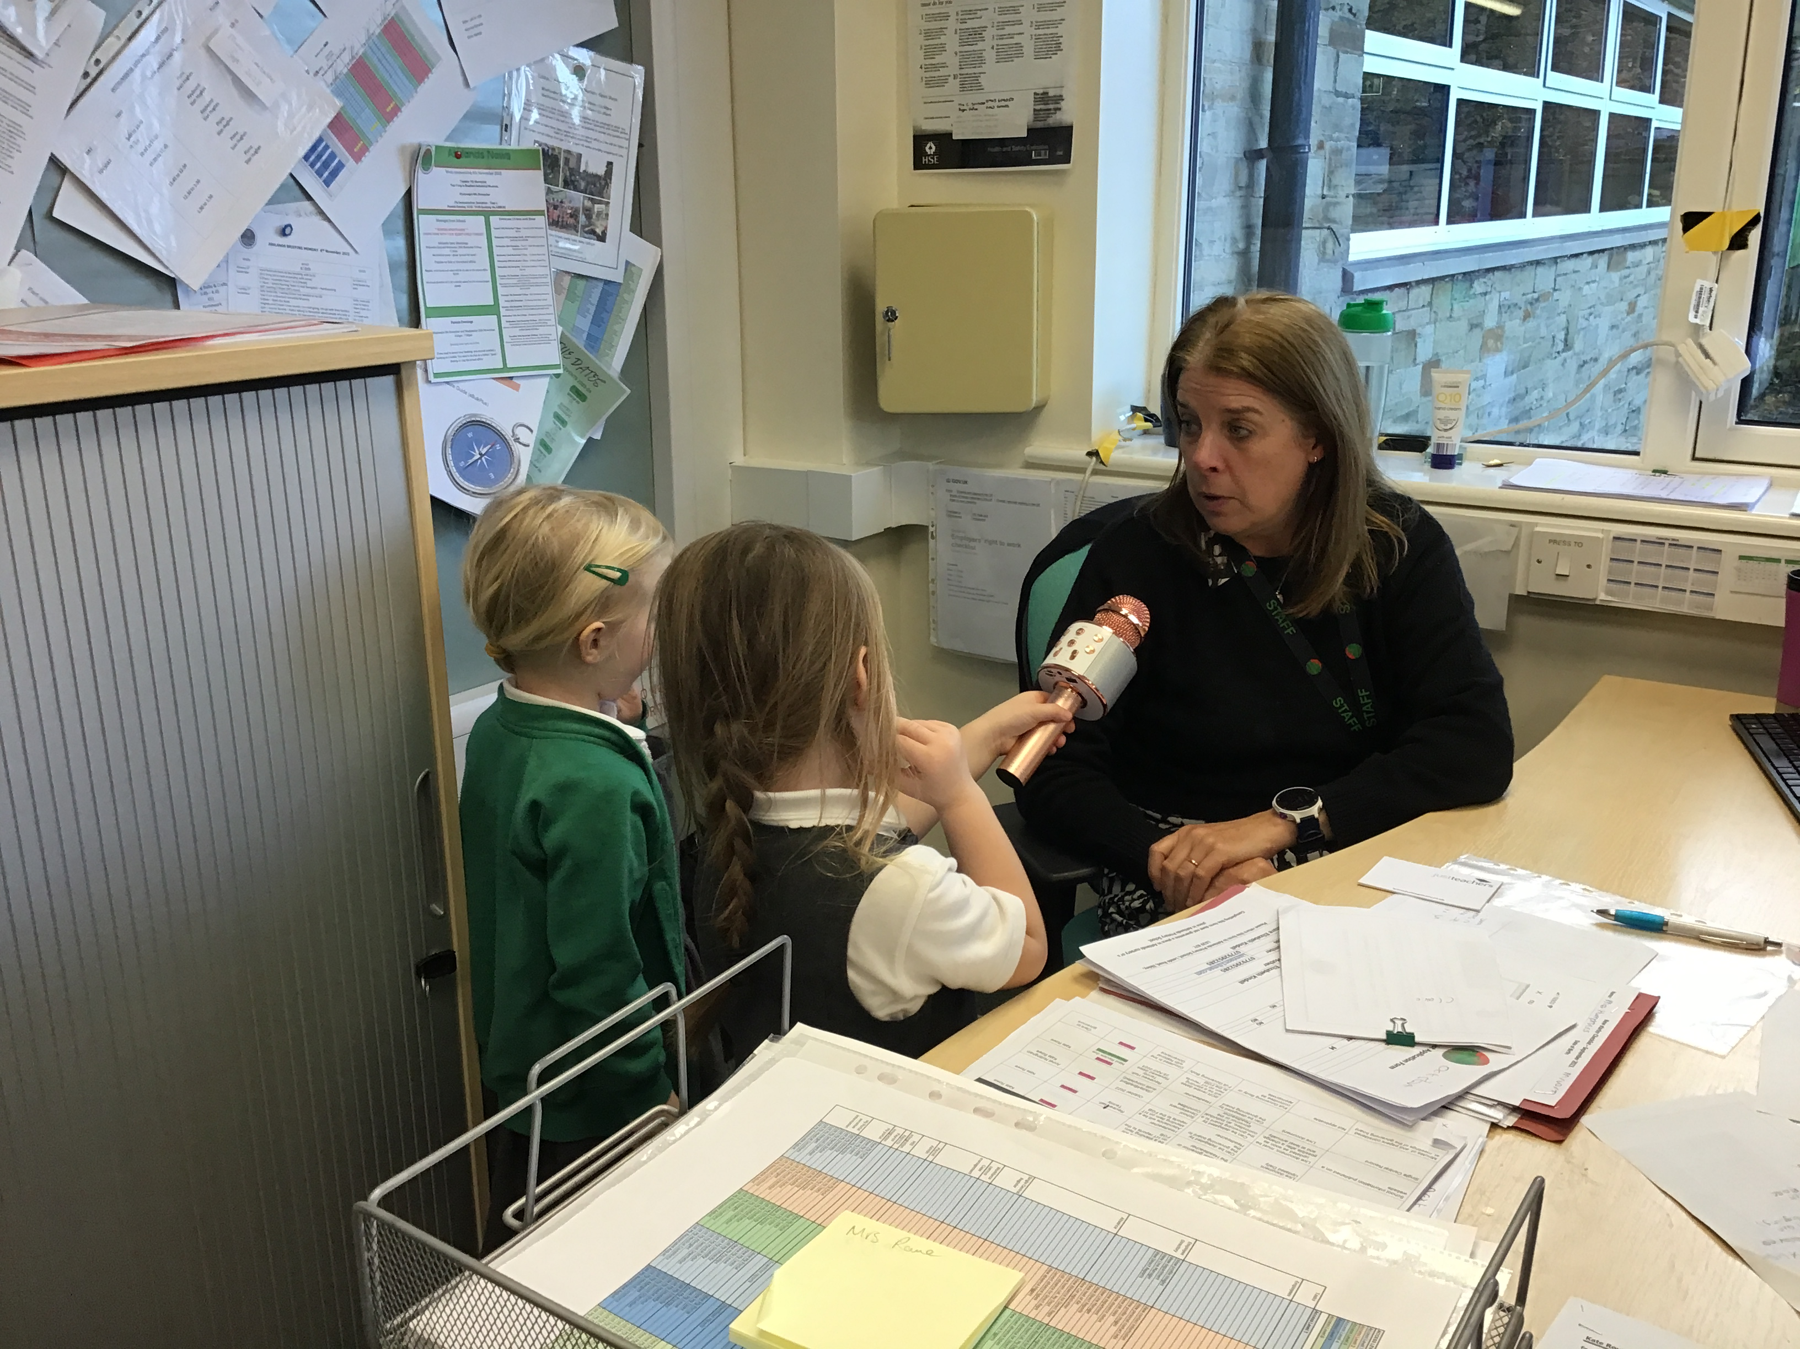
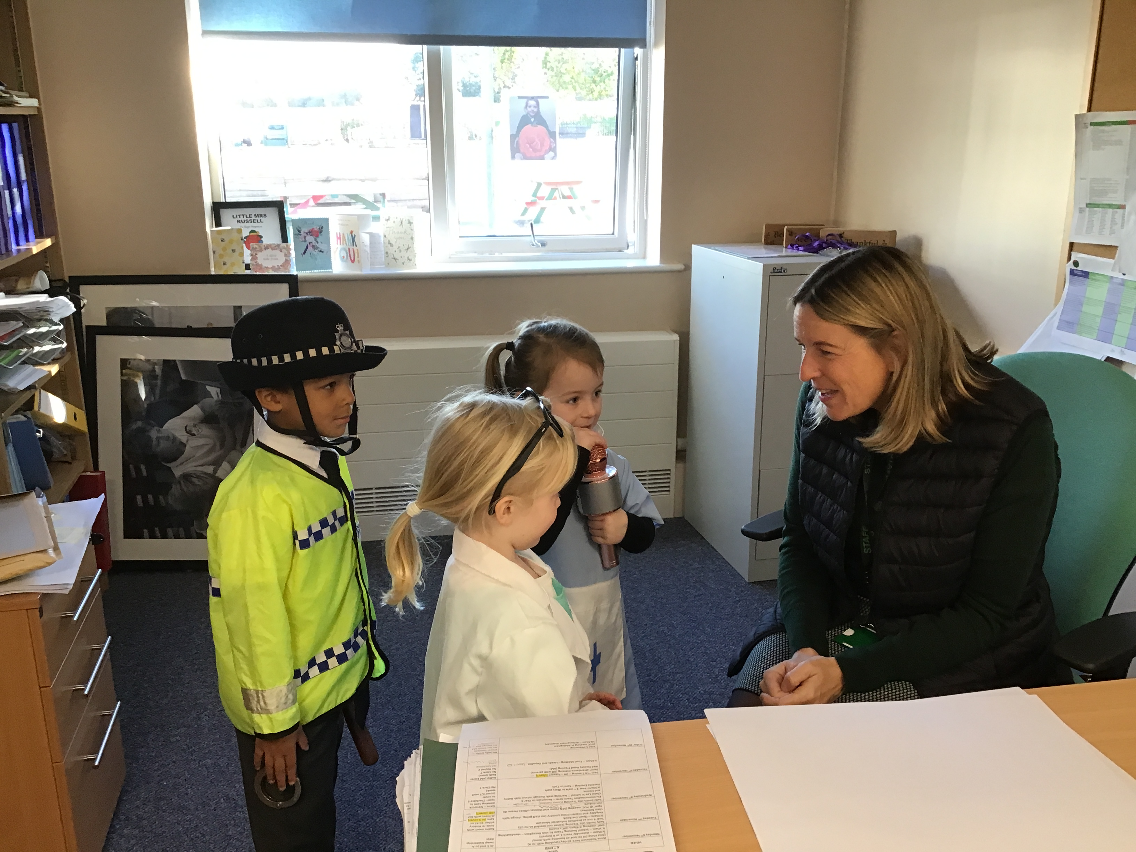

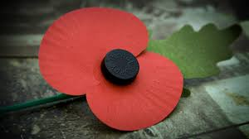
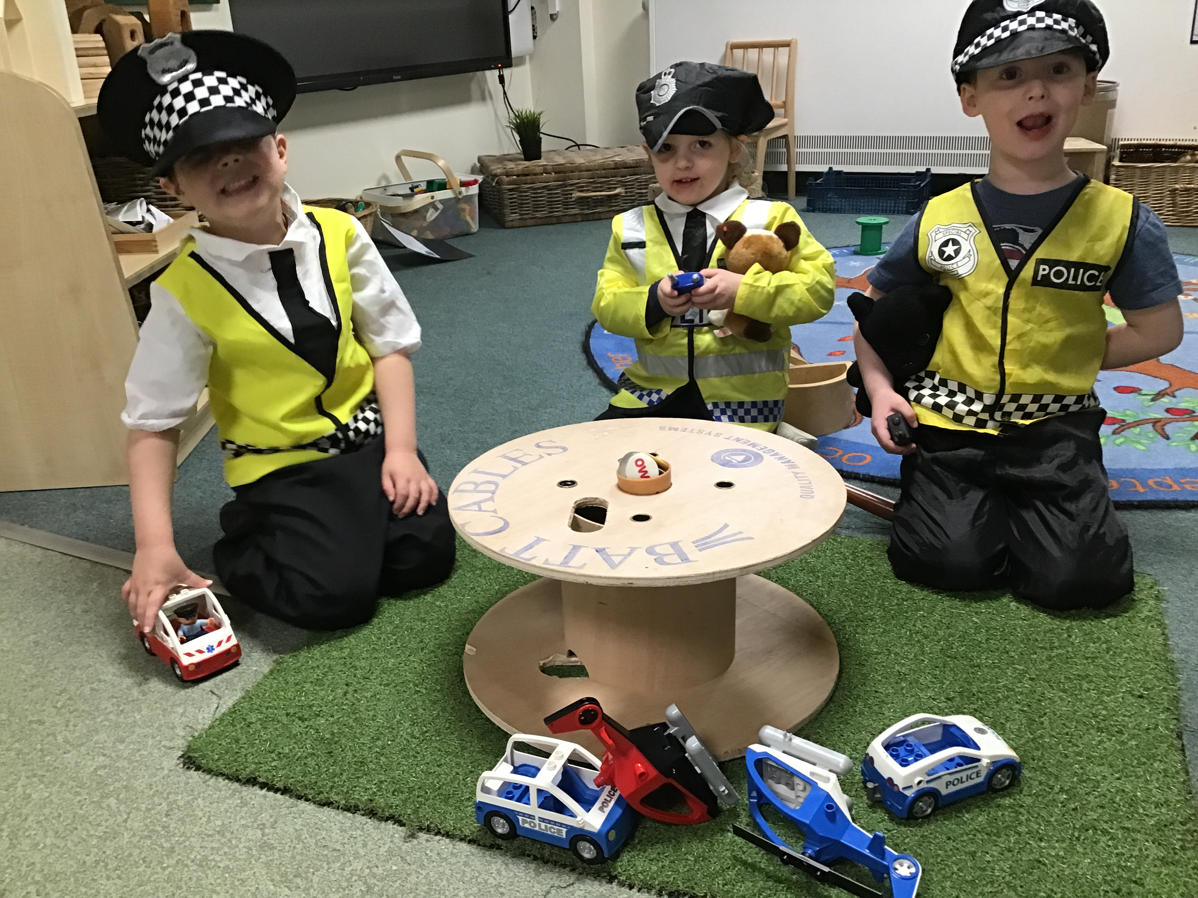
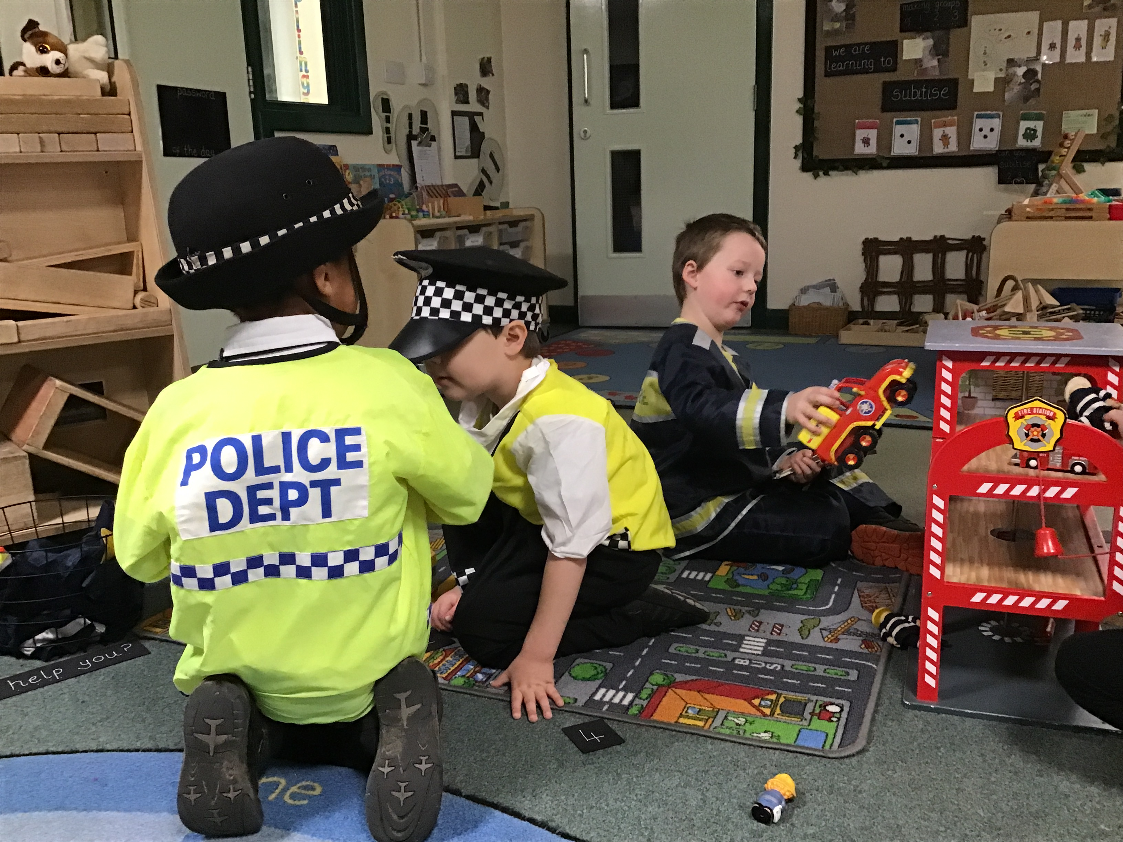



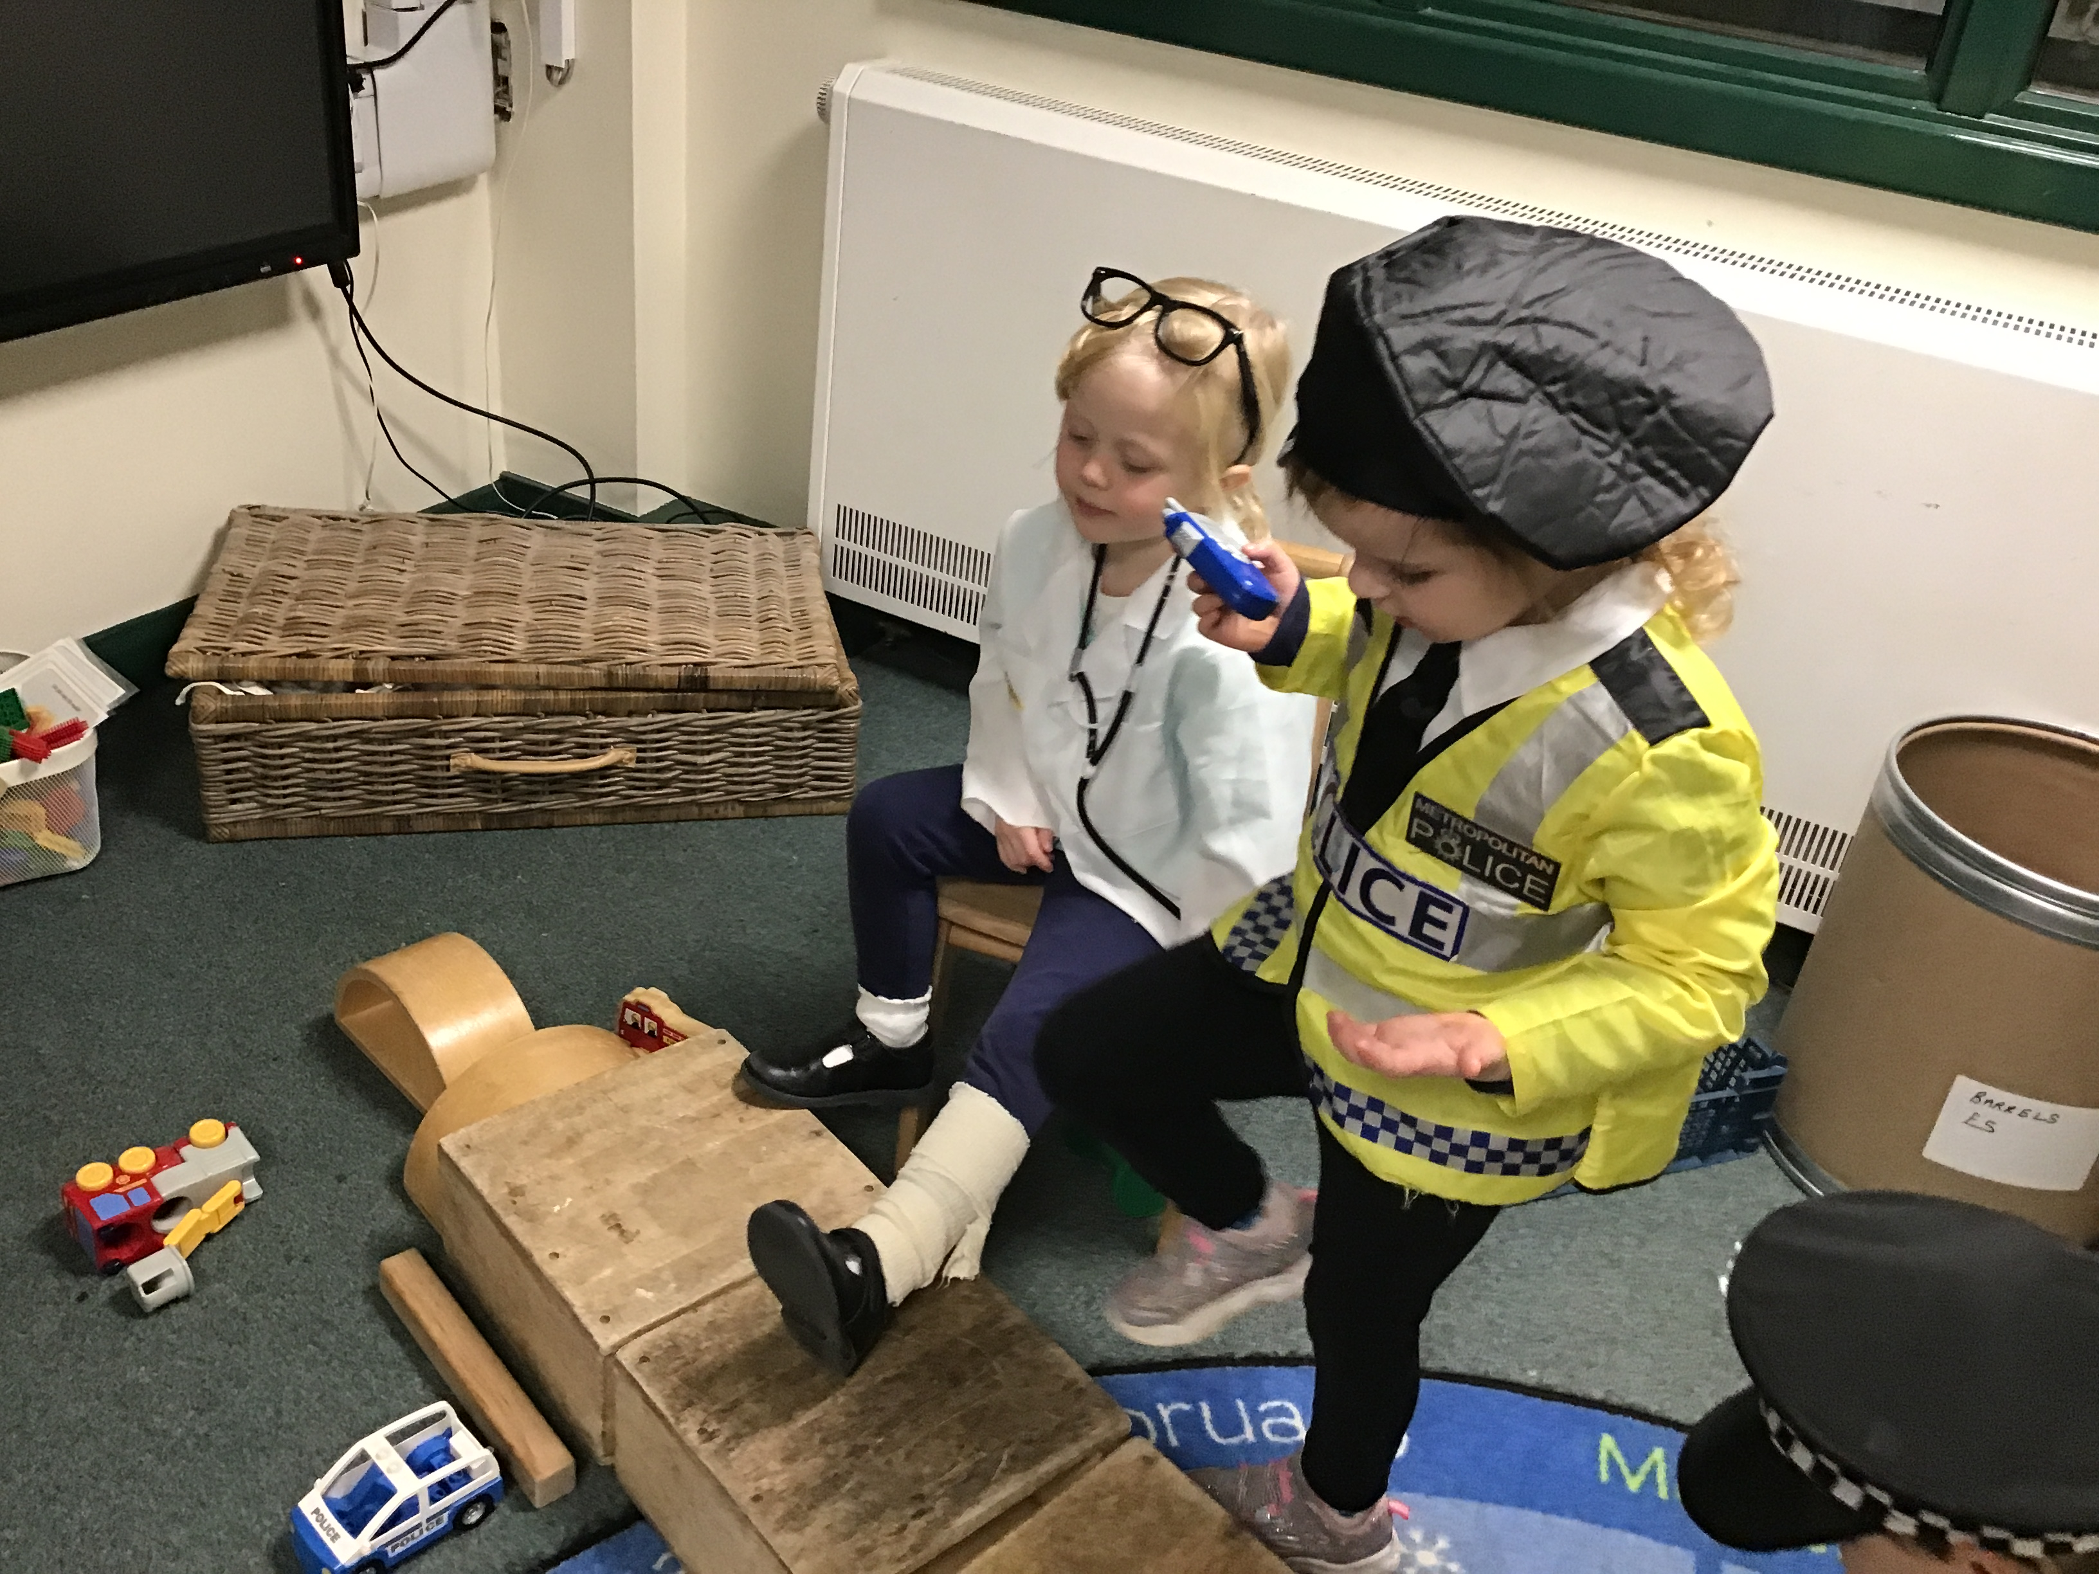
Newsletter 10th November
We have had a brilliant week in Reception, building on our WOW Day experiences and talking about 'People Who Help Us'.
We had a visit from our local Community Support Officer, Joanne, who talked to the children about the Police Force and how she helps us to keep safe.
She told the children that if they are lost, asking for help in a shop is a good idea. Knowing their parents' full name and where they live is a good thing to learn.
Literacy
We have enjoyed learning more about the People Who Help Us in our community and particularly those who look after us at school. Members of staff have been 'interviewed' by the children and asked 'how do you help us?"
Maths
We have been learning the terms 'part' and 'whole' to describe numbers.
There is an excellent Numberblocks episode which explains this really well BBC iPlayer - Numberblocks - Series 1: The Whole of Me
Composition of numbers is a concept we build upon throughout Reception.
Personal, Social and Emotional.
There are lots of opportunities in the classroom to encourage sharing and taking turns.
The children are becoming much more confident with negotiating these important skills.
Knowledge and Understanding
Sharing our knowledge and
experiences of festivals, and
events helps the children to
feel connected to the community
Communication and Language
Talking, talking,
talking. Our role play helps
to secure our confidence
with new vocabulary.
Physical Development
Life Skills! This week I showed the children how to hang dressing-up clothes on a hanger...ask them to impress you with this new skill at home! I can't promise it will transform tidy up time, but it might help a bit!! Work in progress!

